Slide 1
REII 327 Design 2017
Randolph Bock 25905570
FJ Fourie 26047799

Slide 2
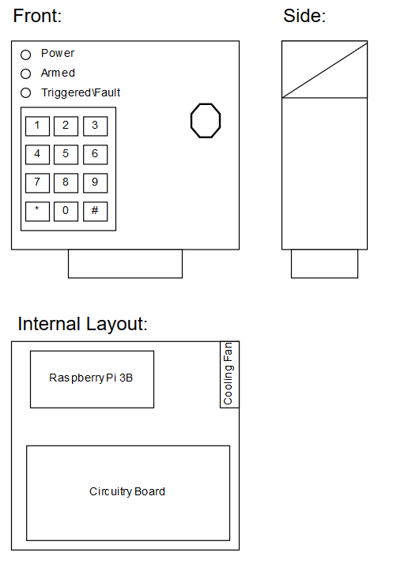
Member A: Randolph Bock
Scope of work
Requirements
Fit
Form
Function
Interfaces
Human/ Machine
Audio & Visual
Network
Sensors
Electrical
Power connection
Protection

Slide 3
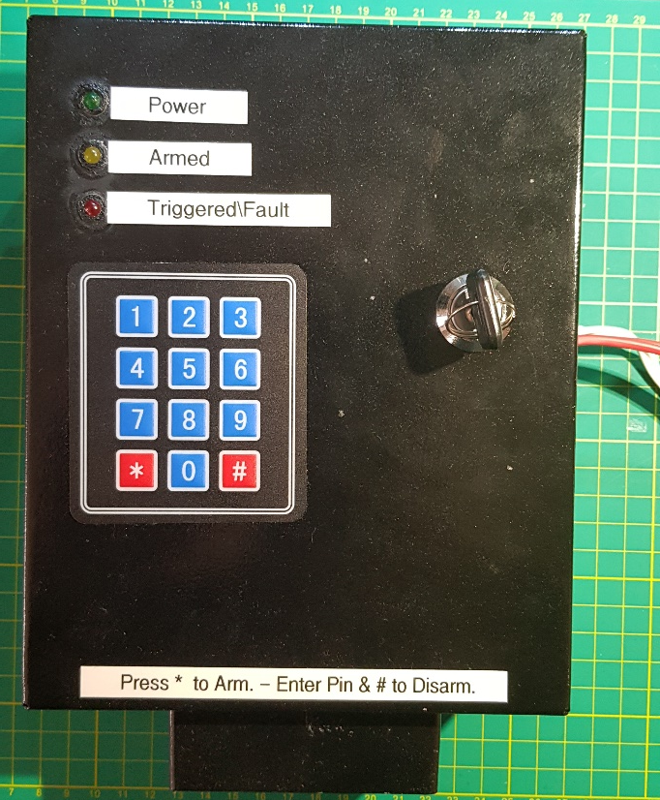
Member A: Randolph Bock
SoC/ System on Chip
Raspberry Pi 3
Raspbian OS (Linux Distro)
Python scrip for program
Auto run program on Startup
Used methods
Functional Analysis
Flow charts
Finite State Machines
Simulations
Program specific Developing environments
Version control
Results

Slide 4
Member B: FJ Fourie
Scope of work
Requirements
Fit
Form
Function
Interfaces
Database and server
Database is hosted on the server
Network
Back end program connected to the server
Back end program connected to the Alarm Box unit
Human Interface
Operator and the backend program

Slide 5
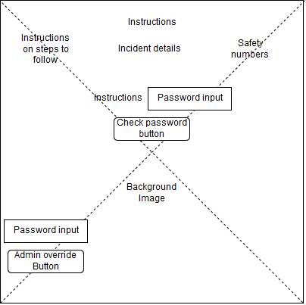
Member B: FJ Fourie
Engineering tools used
QT programming environment
MySQL
C++ programming language
Localhost server
Used methods
Functional Analysis
Flow charts
Universal modeling language (UML) diagrams
Protocol designs
Program specific Developing environments
Version control

Slide 6
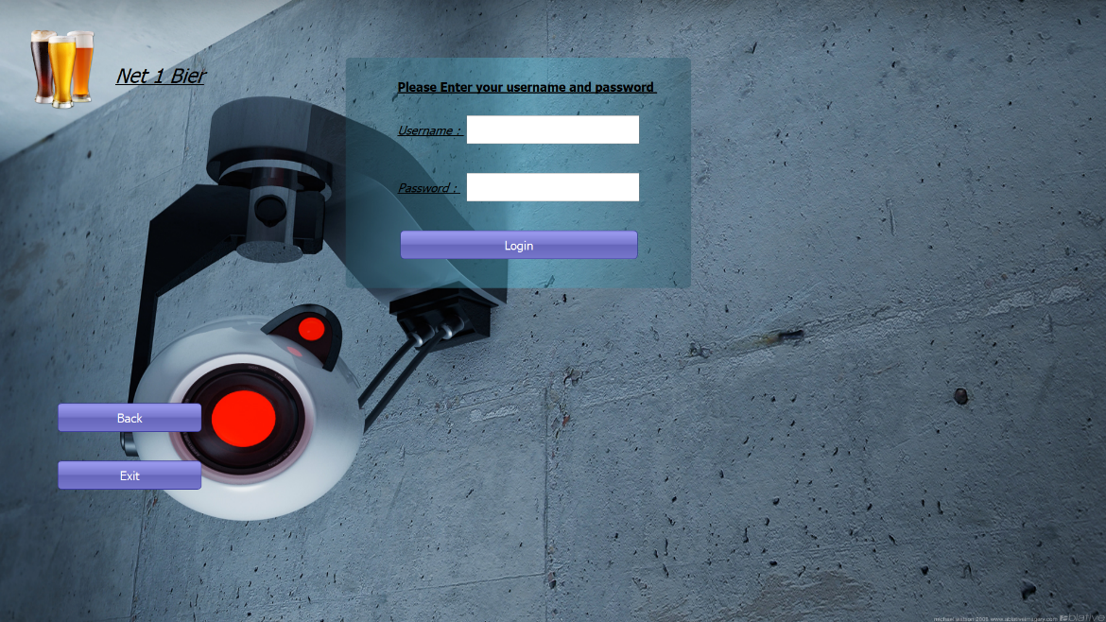
Team: Net 1 Bier
Meetings + Timeframe decisions
Each member had a chance to be chairperson
Each member gave input to design choices
Progress was tracked
Timeframe, and deadline allocated
Non-participating member
Given chance to recover and participate
Change control (N1B001) request and acceptance
Change in work allocation

Slide 7
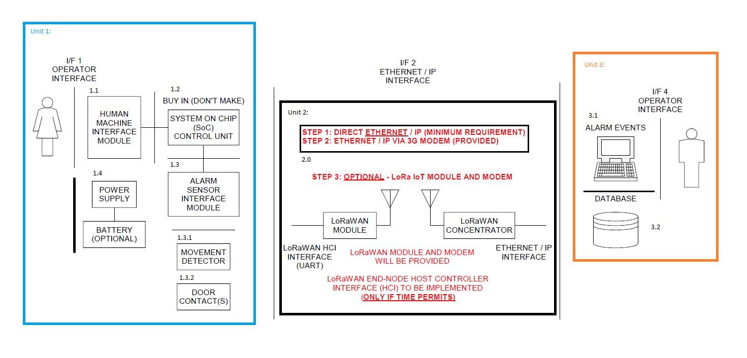
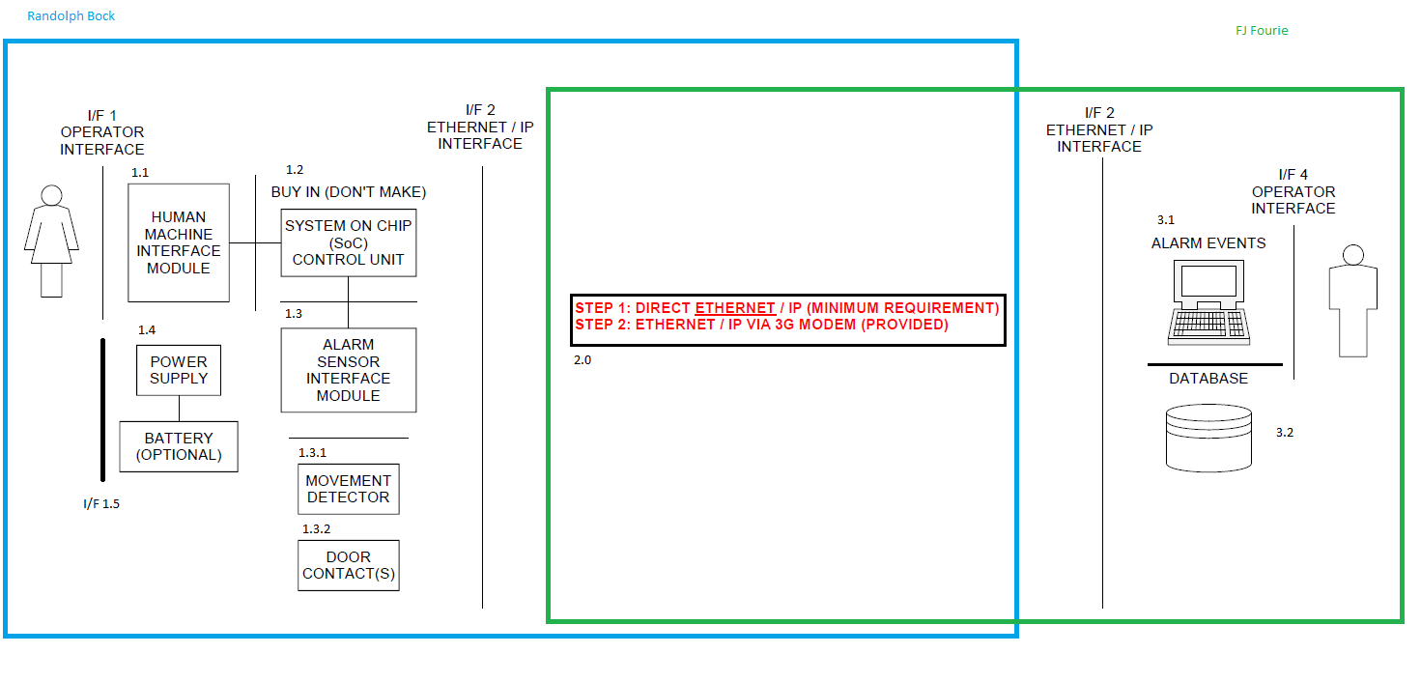
Team: Net 1 Bier

Slide 8
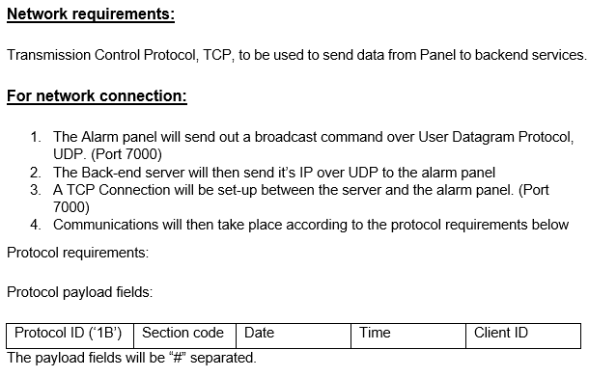
Team: Net 1 Bier
Network Interface
Interface Control Document
Network communication done via WIFI, and wireless router
TCP Connection
Specific payload as ICD
Integration:
Only one interface integration required
Network communications
Testing of network Communications
Final integration

Slide 9
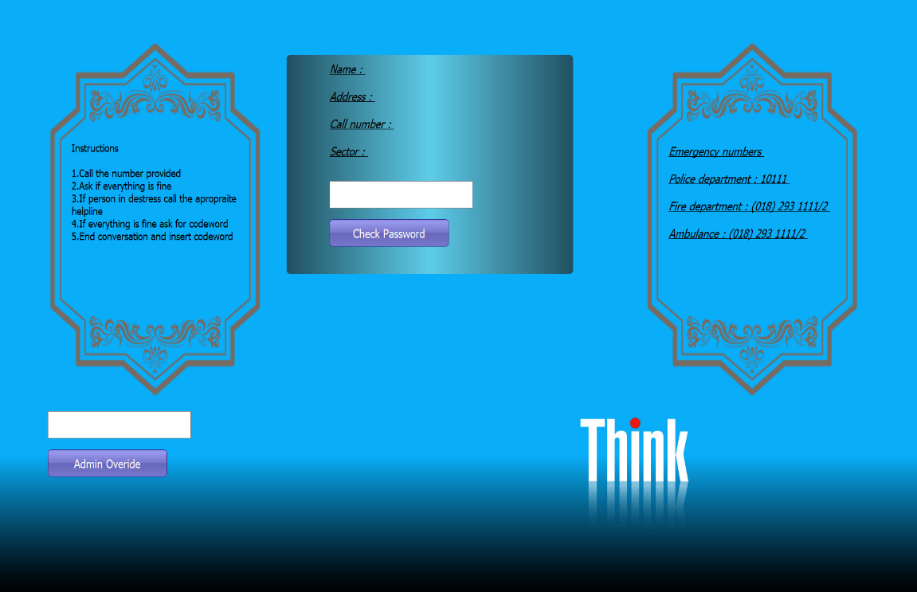
Team: Net 1 Bier
Testing
All scenarios tested.
Errors corrected
Testing done in lab
Network communication done via WIFI, and wireless router
Results
Alarm panel results
Backend Program Results
Integration results

Slide 10

Thank you

